Slide 1
Chemical treatments (324 conditions)
E. coli single deletion (3979 mutants)
5% FDR
Notes:
Color scales are the same as the first 50 X 50 for both quantitative and qualitative

Slide 2
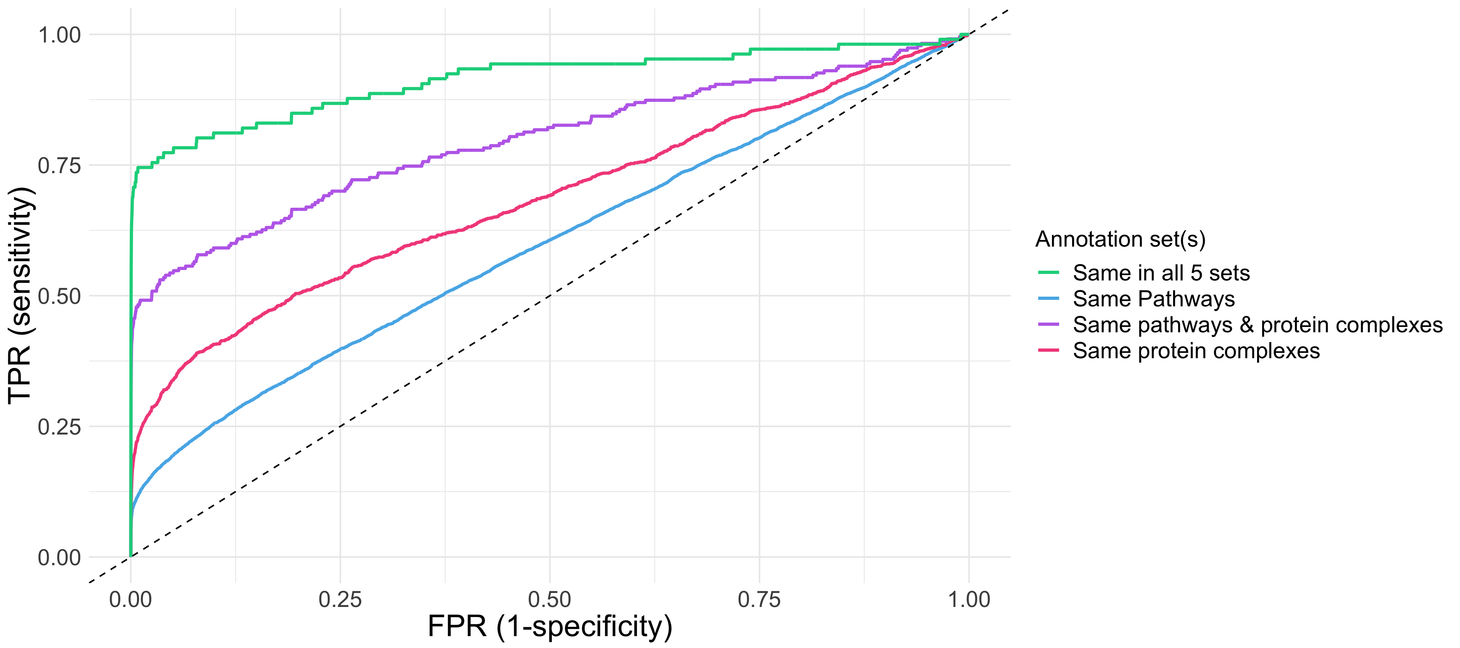
AUC: 0.91
AUC: 0.80
AUC: 0.68
AUC: 0.60

Slide 3
|PCC| of ~ 0.6 gives optimal precision & sensitivity
Notes:
Be sure to explain the numbers

Slide 5
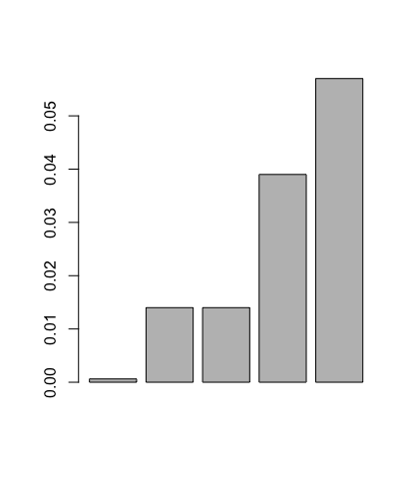
Co-annotations enrich profile similarity
***
Mean
***
Mutual Information
***
***
All gene pairs
Same pathways
Same protein
complexes
Same pathways &
protein complexes
Same in all 5 sets
Notes:
From left to right:
#Median: 0.00 #Mean: 0.00062
#Median: 0.00 #Mean: 0.014
#Median: 0.00 #Mean: 0.014
#Median: 4.146e-05 #Mean: 0.039
#Median: 0.035 #Mean: 0.057
If the no. is log scale => lots of log(0) (NaN)
Why do many high MI pairs disappear when I use all annotation sets?
*I tired using offset=1 with log(base=10) , offset=1 with log(base=10000). offset=10 with log(base=10). All give almost identical graph as the original one
=> too many are 0. No matter how much we scale, it would be the same

Slide 7
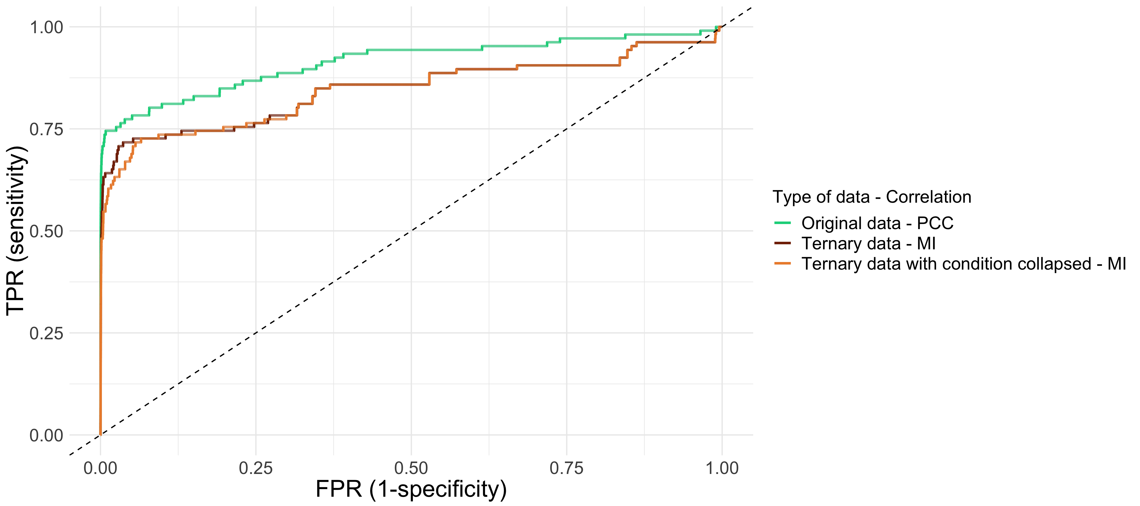
ROC for different fitness
- Area under the curve
- 0.91
- 0.84
- 0.84

Slide 8
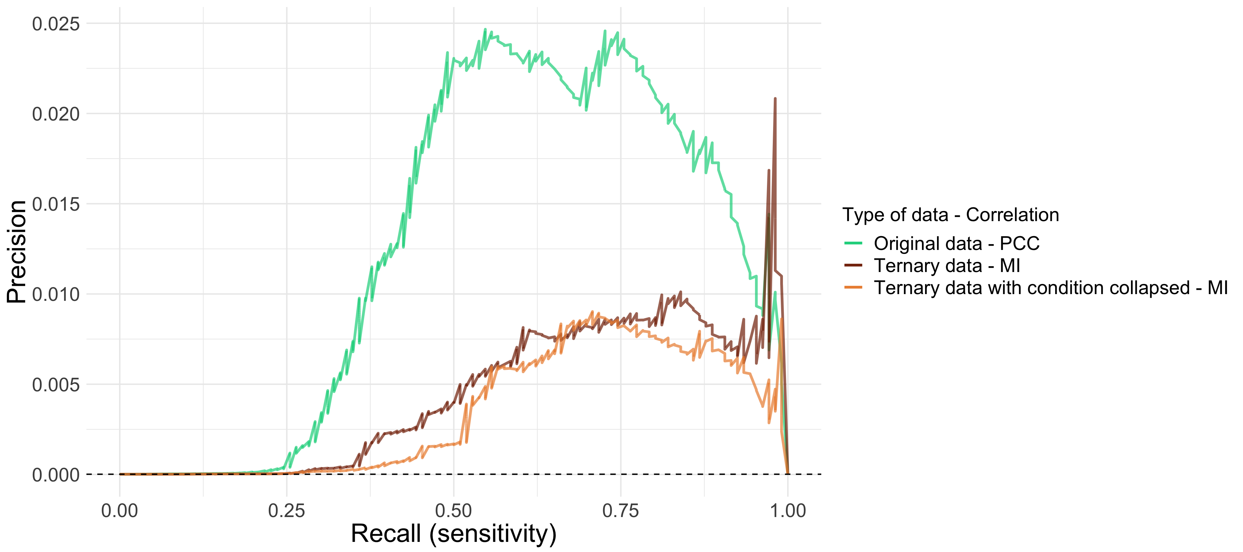
PRC for different fitness
- Area under the curve
- 0.012
- 0.0043
- 0.0033
Area under the curve for random classifier (dotted line): 0.00013

Slide 9
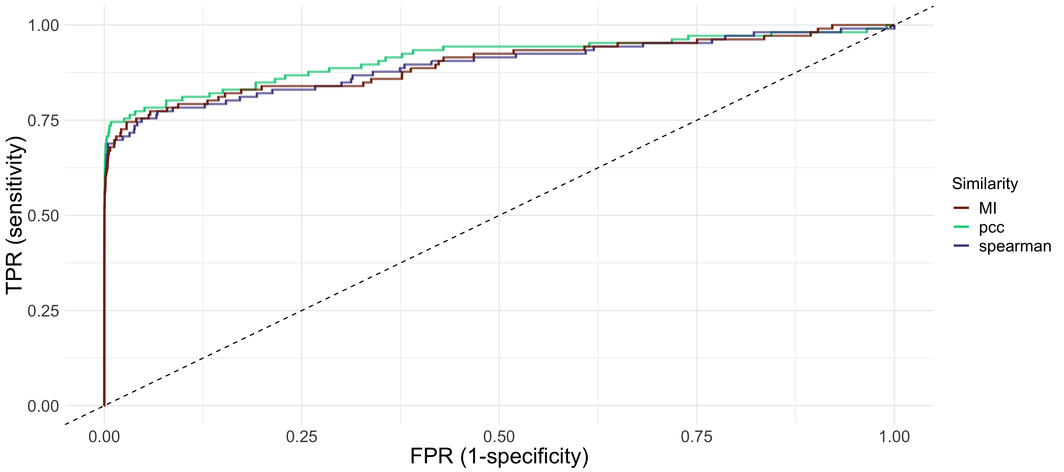
ROC for different distances
- Area under the curve
- 0.90
- 0.91
- 0.89
Notes:
pcc AUC: 0.91
spearman AUC: 0.89
MI AUC: 0.90

Slide 10
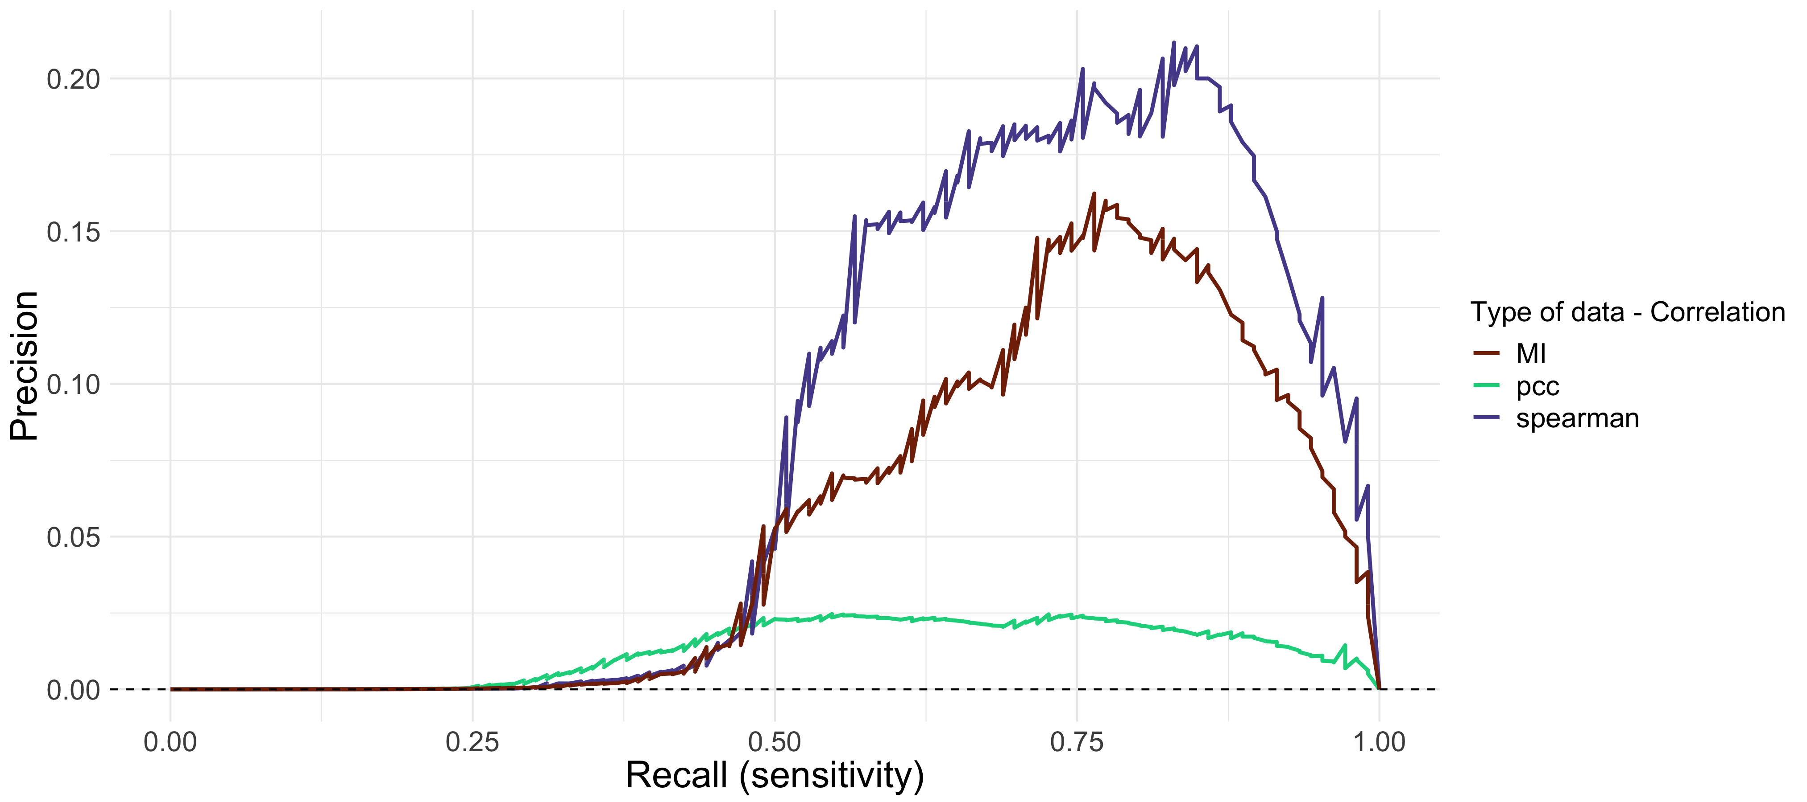
PRC for different distances
- Area under the curve
- 0.053
- 0.012
- 0.079
Area under the curve for random classifier (dotted line): 0.00013

Slide 12
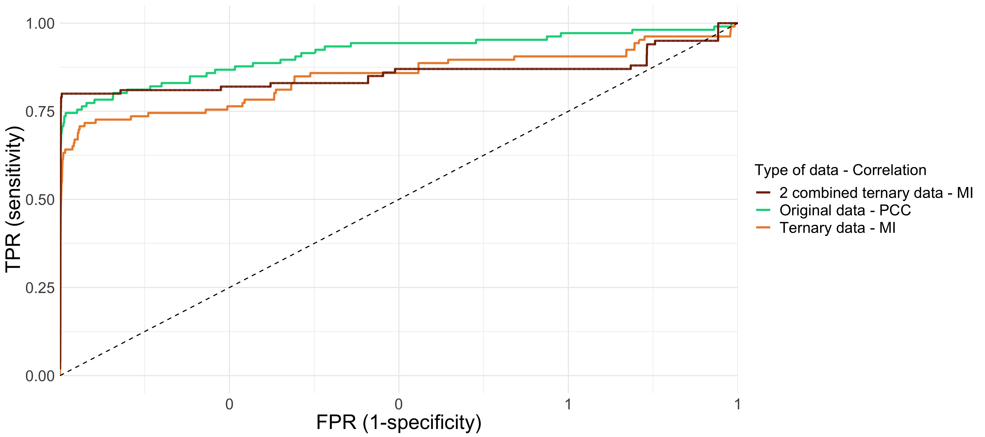
ROC for different fitness + Price’s
<- Note: have to fix x axis
Notes:
*For “2 combined ternary data - MI”, only genes in Nichols’ and Price’s are used

Slide 13
Different studies can be combined
Notes:
Dr. Hu doesn't like the dark yellow and brown
make the lines thicker

Slide 14
Notes:
*|PCC| for metabolic pathways
*AvgPCC_pwy&ptcomplex_obj_prep.R + AvgPCC_pwy&ptcomplex.R

Slide 15
Notes:
*|PCC| for protein complexes
*AvgPCC_pwy&ptcomplex_obj_prep.R + AvgPCC_pwy&ptcomplex.R

